Slide 1
Apache Hadoop 2.7.2 Installation Guide
Haimonti Dutta
haimonti@buffalo.edu

Slide 2
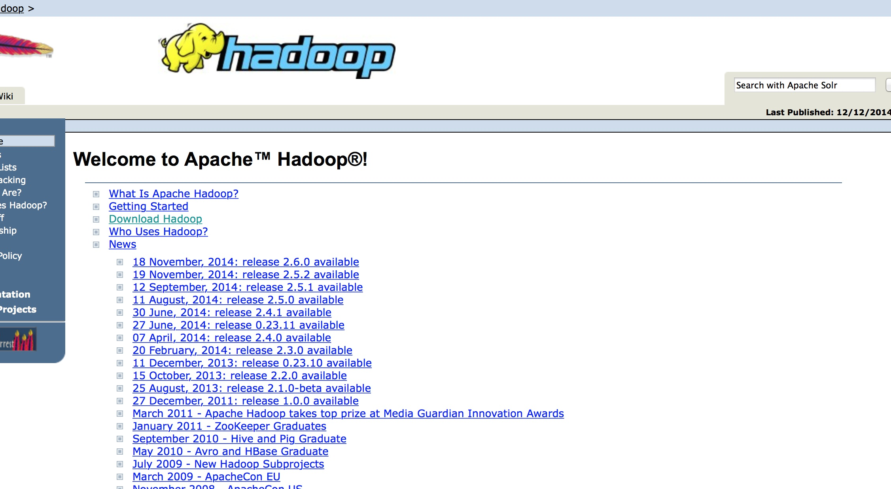
Download a stable release..
1. Visit https://hadoop.apache.org
2. Download Hadoop from the releases link – You need a binary tarball
3. The latest release is 2.7.2

Slide 3
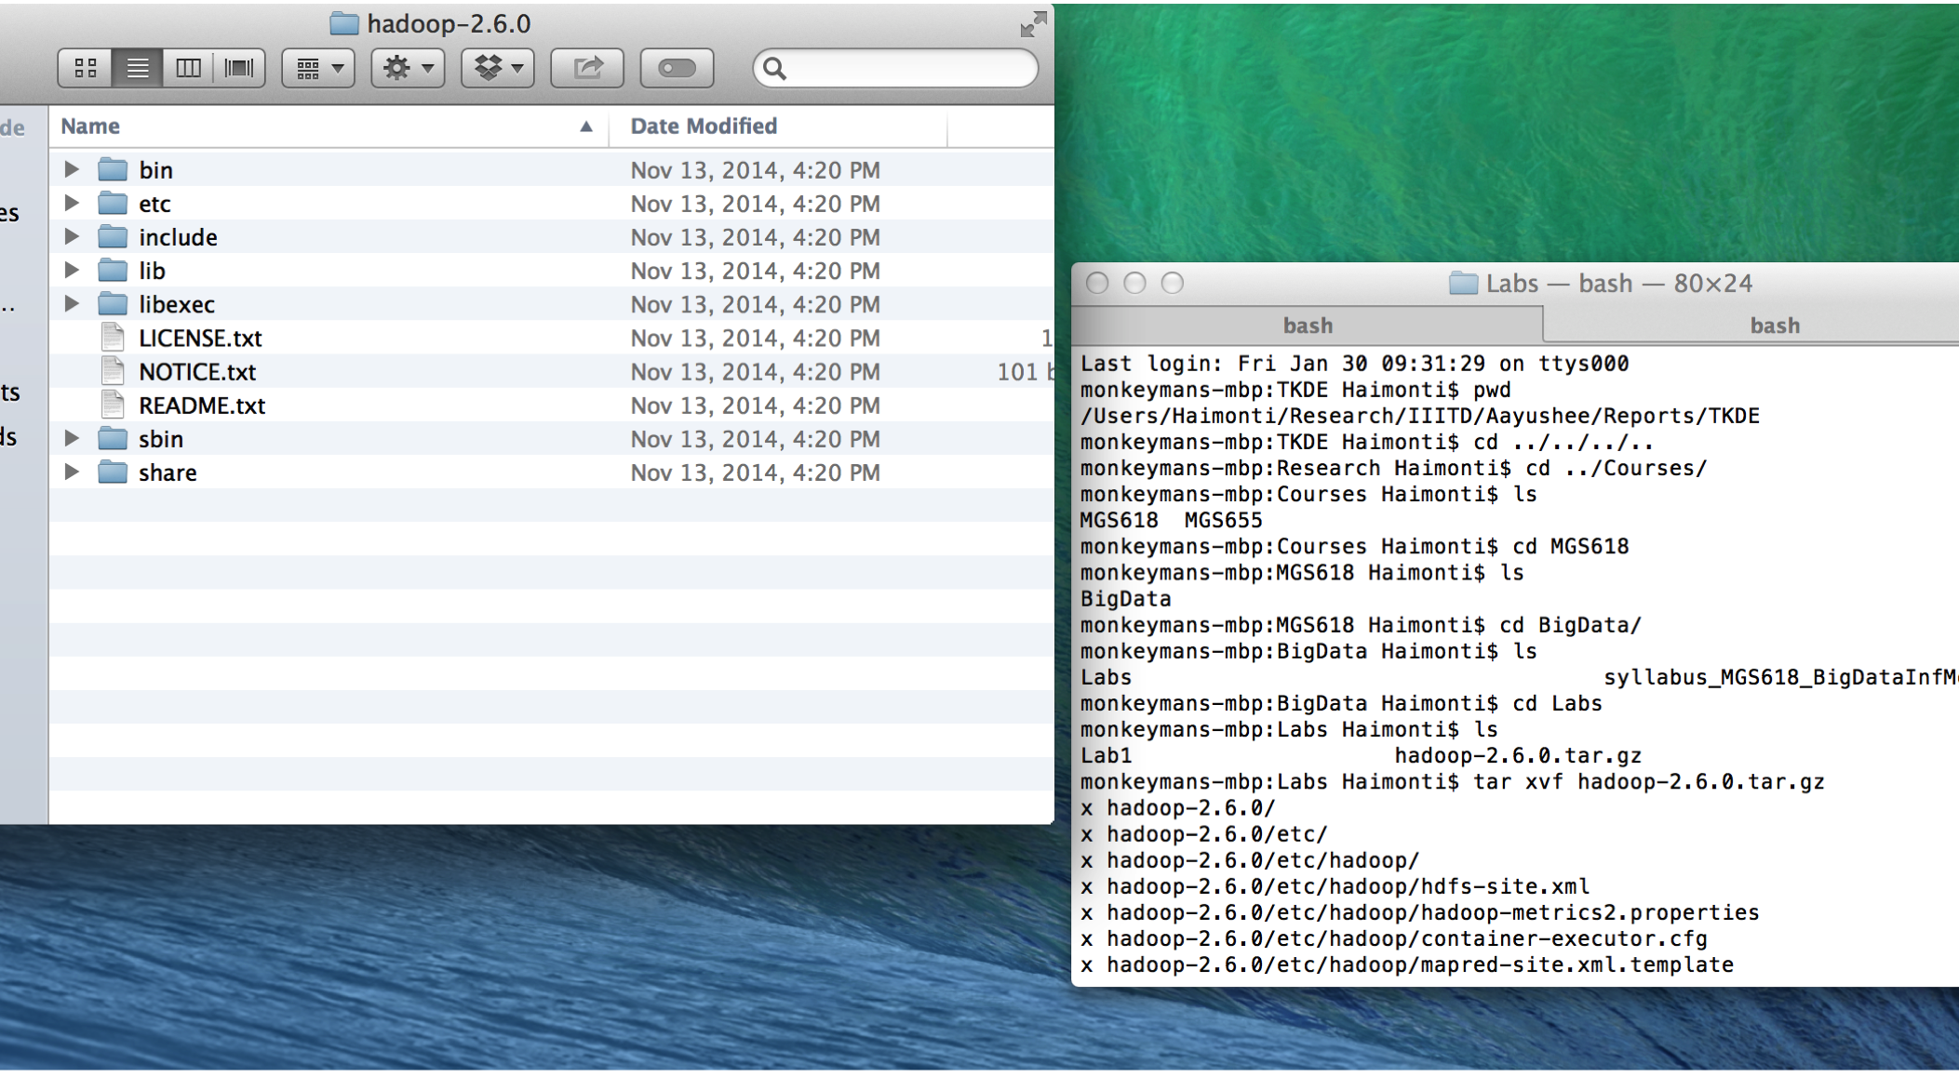
On un-tarring you should have this..

Slide 4
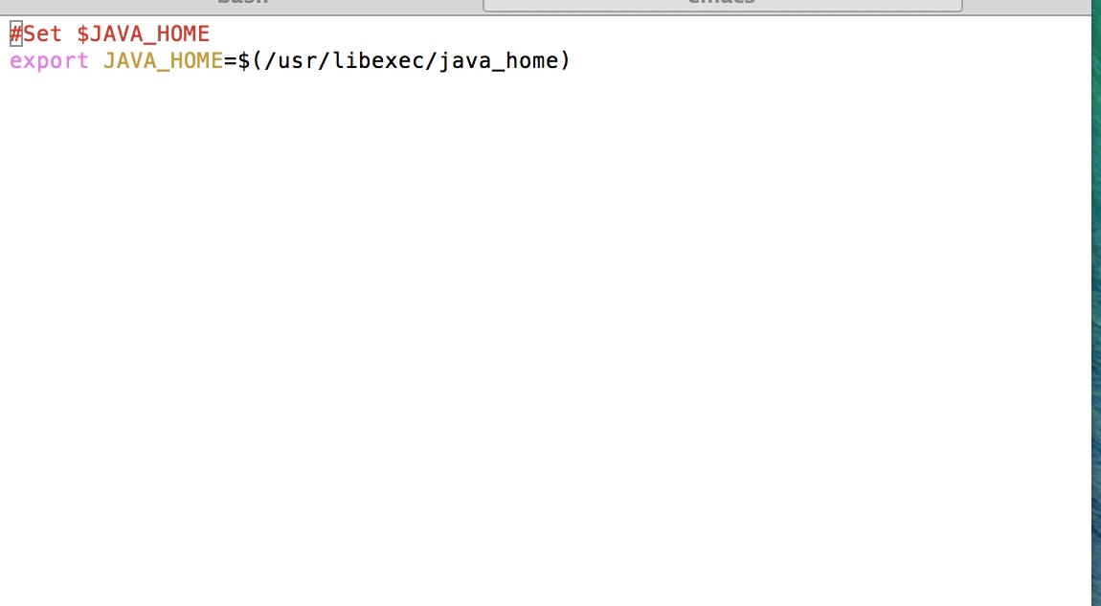
Setting the JAVA_HOME environment variable

Slide 5
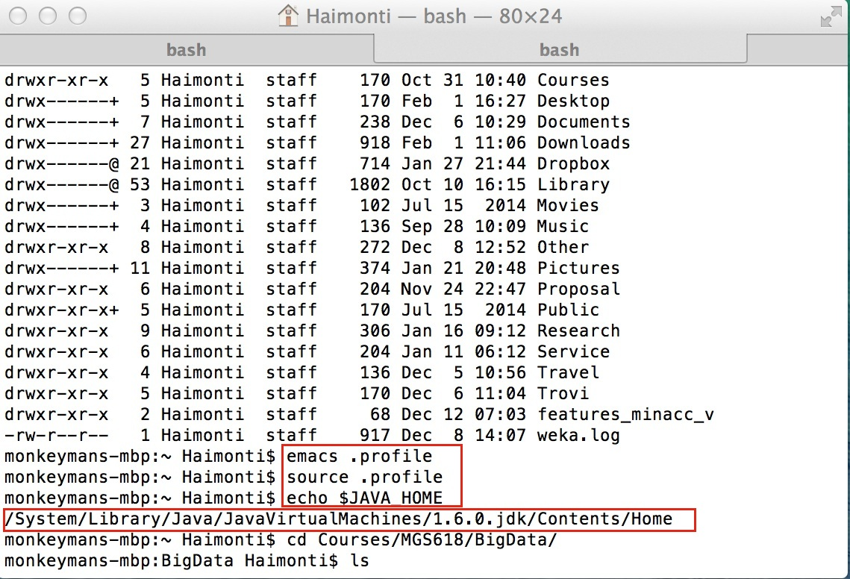
After setting JAVA_HOME env variable

Slide 6
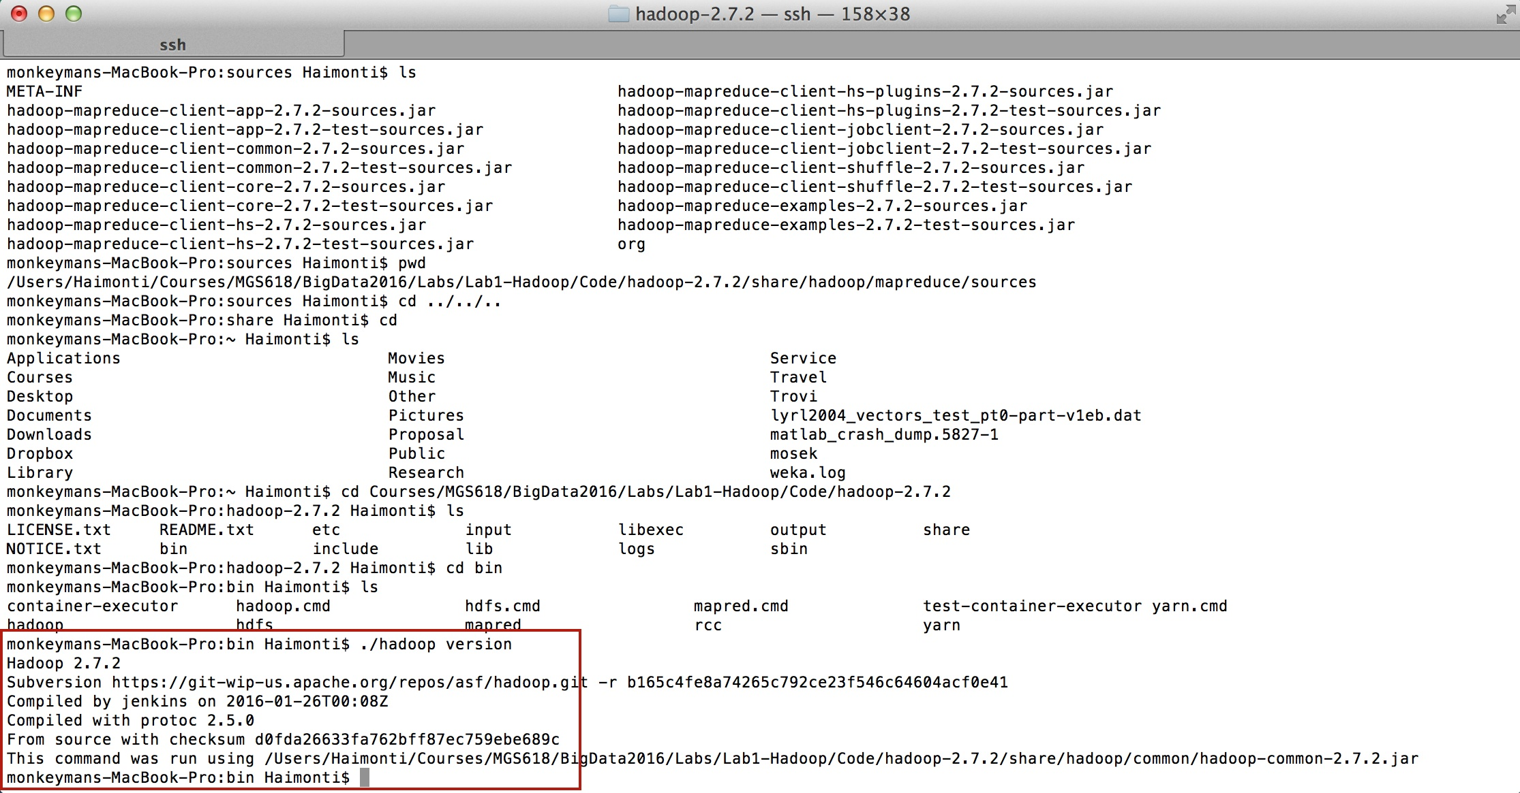
Testing the installation

Slide 7
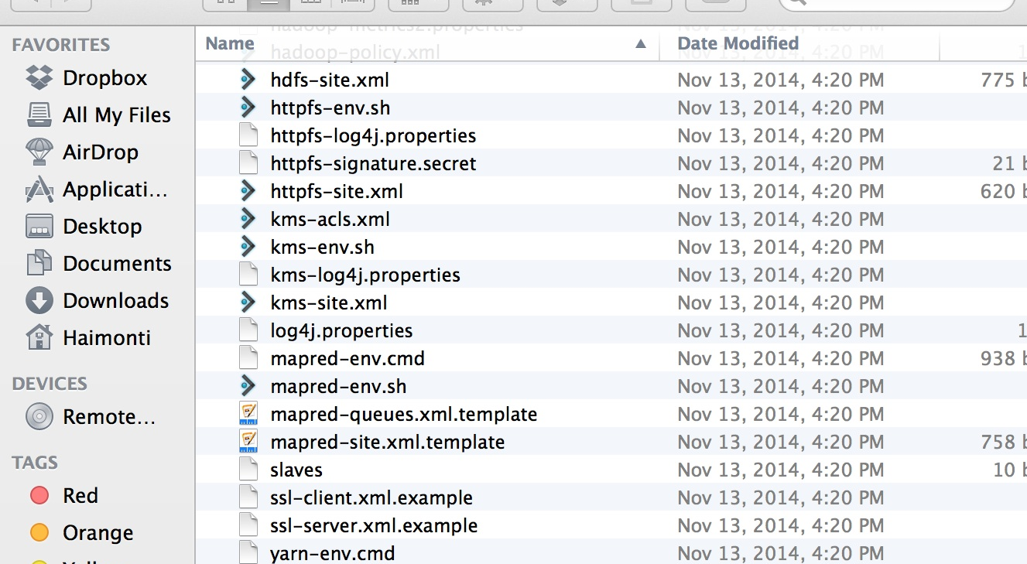
Hadoop Configuration
1. Go to <hadoop-install-dir>/etc/hadoop
2. You will find the following files:
core-site.xml, hdfs-site.xml, mapred-site.xml, yarn-site.xml
3. Hadoop 2.7.2 uses Yarn for resource management and scheduling and hence this needs to be configured.

Slide 8
Hadoop in Pseudo-Distributed Mode
Three files need to be edited
core-site.xml
hdfs-site.xml
mapred-site.xml
yarn-site.xml

Slide 9
Edit core-site.xml as shown below
<configuration>
<property>
<name>fs.defaultFS</name>
<value>hdfs://localhost:9000</value>
</property>
</configuration>

Slide 10
hdfs-site.xml
<configuration>
<property> <name>dfs.replication</name> <value>1</value> </property> <property> <name>dfs.name.dir</name> <value>/usr/local/data</value> </property></configuration>
The default replication is 3 in HDFS. Since we are doing the install in a pseudo distributed mode on a local machine, we simply set the replication factor to be 1.

Slide 11
Edit mapred-site.xml as shown below
<configuration> <property> <name>mapreduce.framework.name</name> <value>yarn</value> </property> <property> <name>mapreduce.jobhistory.address</name> <value>localhost:10020</value> </property></configuration>

Slide 12
Edit yarn-site.xml as below
<configuration>
<property>
<name>yarn.nodemanager.aux-services</name>
<value>mapreduce_shuffle</value>
</property>
</configuration>

Slide 13
Formatting the HDFS filesystem
Can be done using the following command
./hadoop namenode -format

Slide 14
Starting and Stopping the daemons
Location of scripts: <HADOOP-INSTALL-DIR>/sbin
Two scripts of importance:
./start-dfs.sh [Sets up the DFS]
./start-yarn.sh [Sets up the Resource and Node Managers]

Slide 15
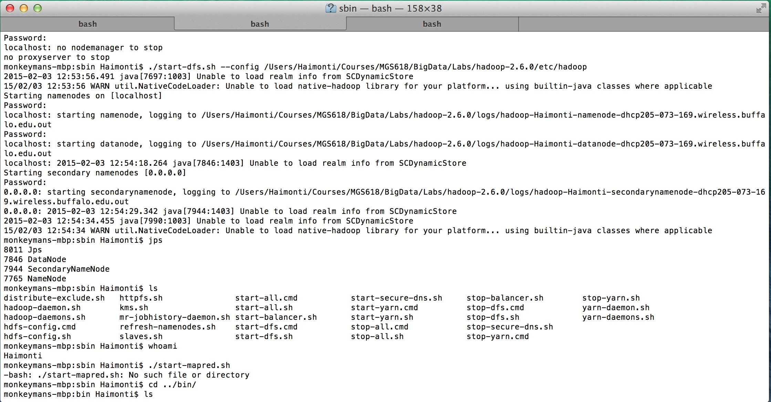
Starting the DFS

Slide 16
Starting the DFS
The hadoop daemon log output is written to $Hadoop_log_dir directory
Browse the web interface for the NameNode
Open a browser
http://localhost:50070
Take time to read through the namenode, datanode configuration

Slide 17
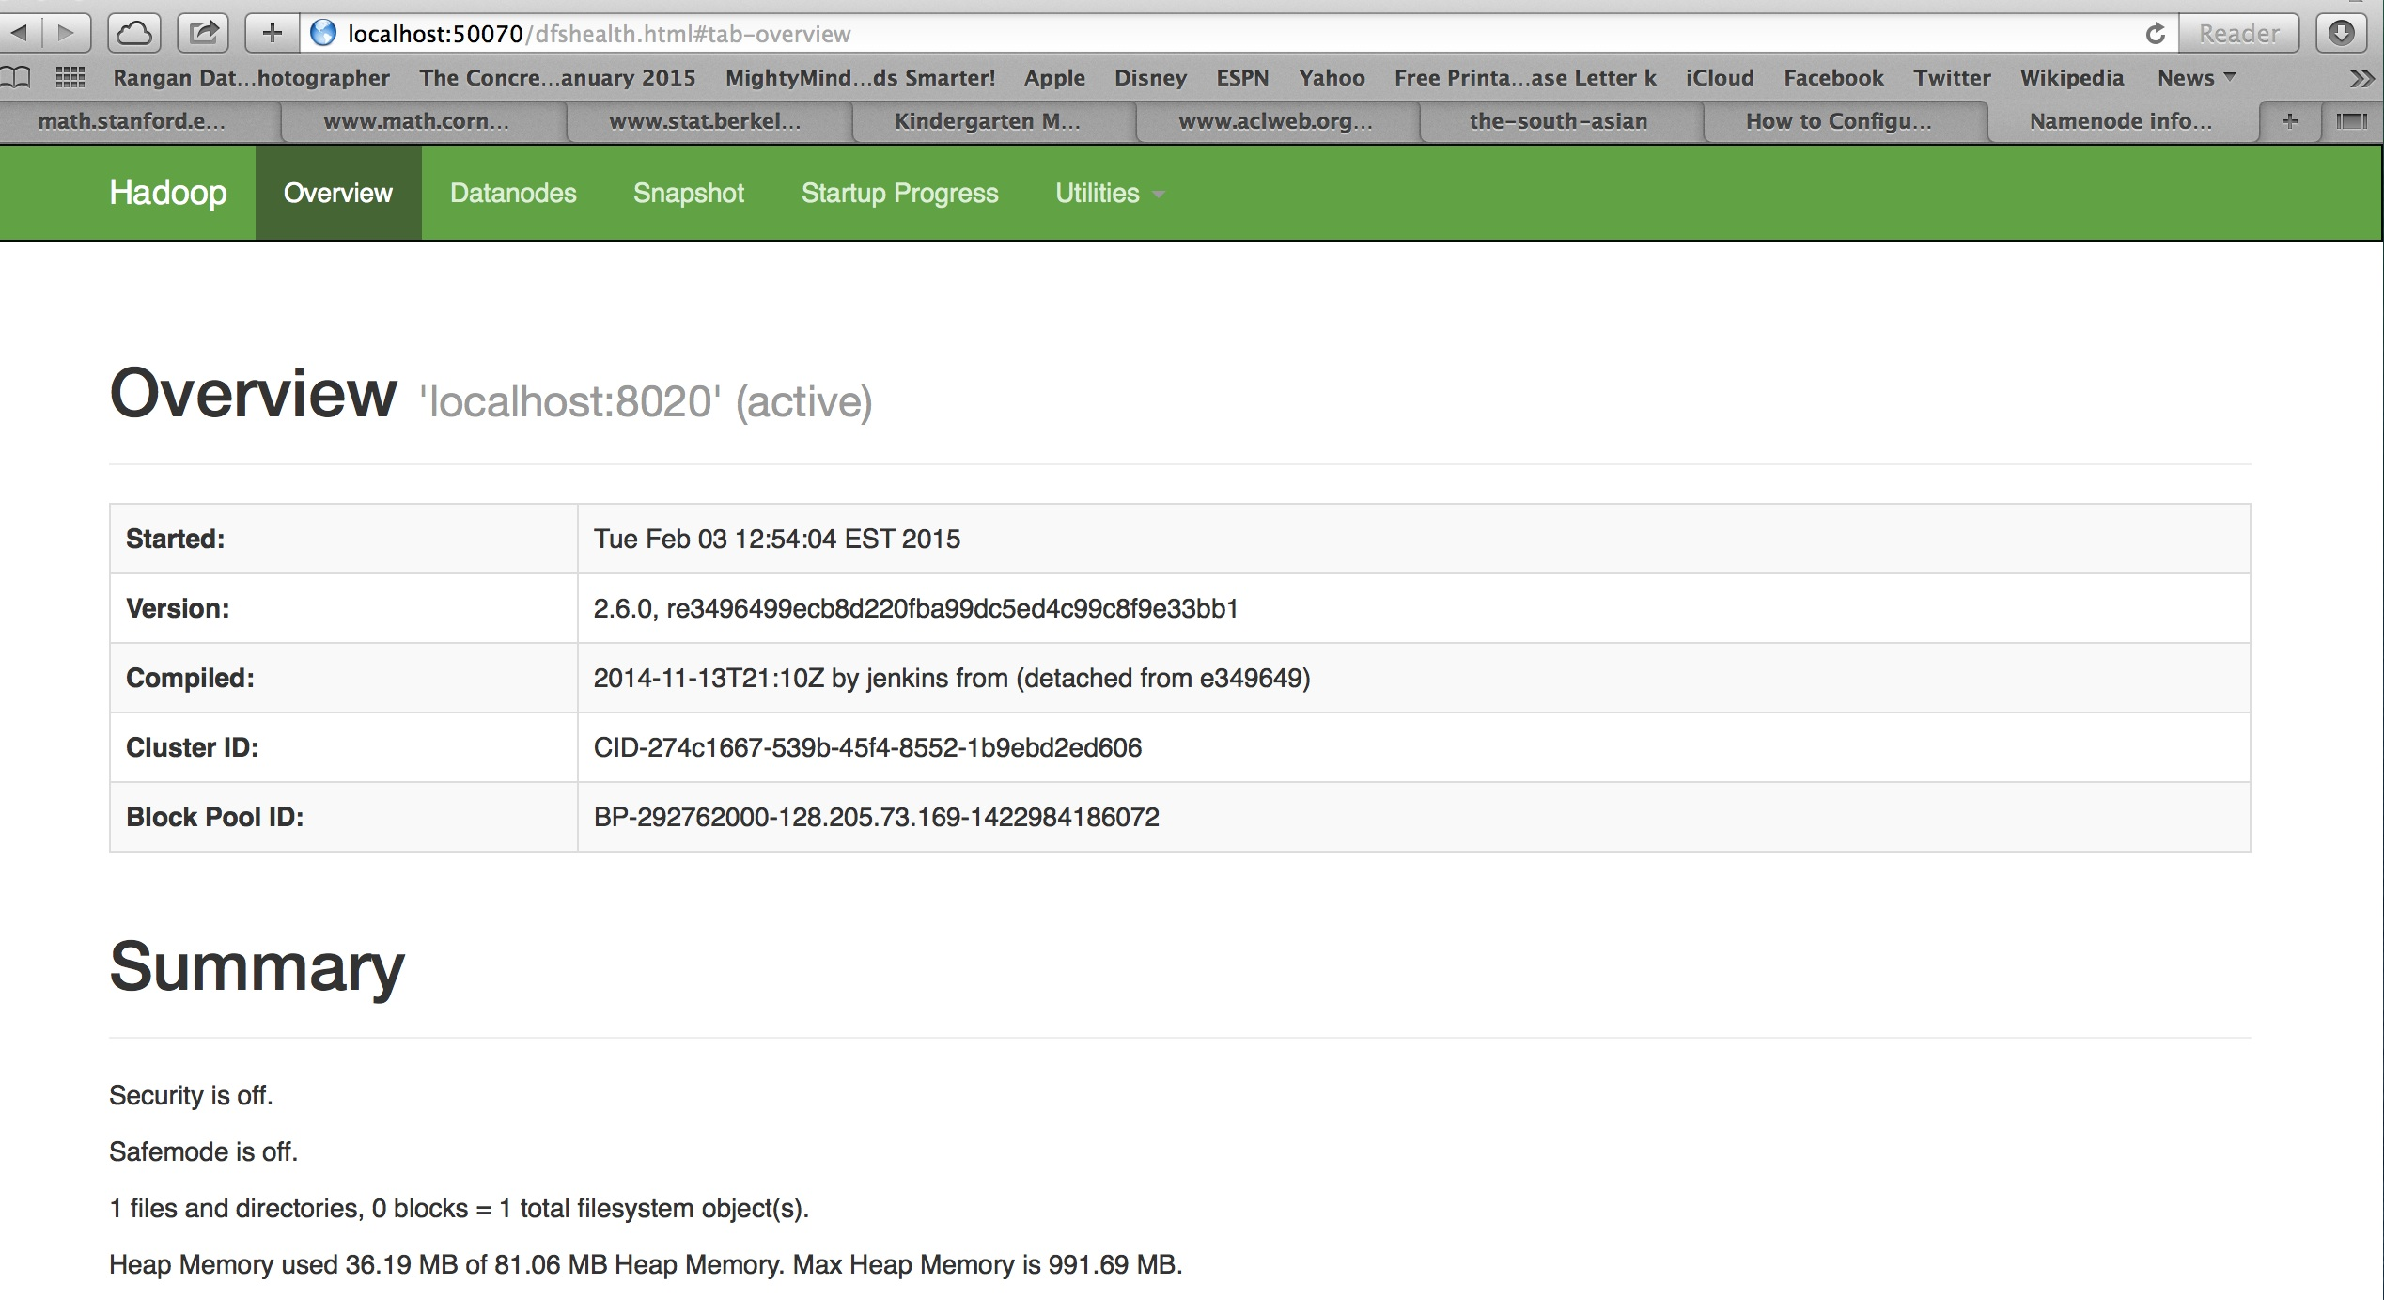
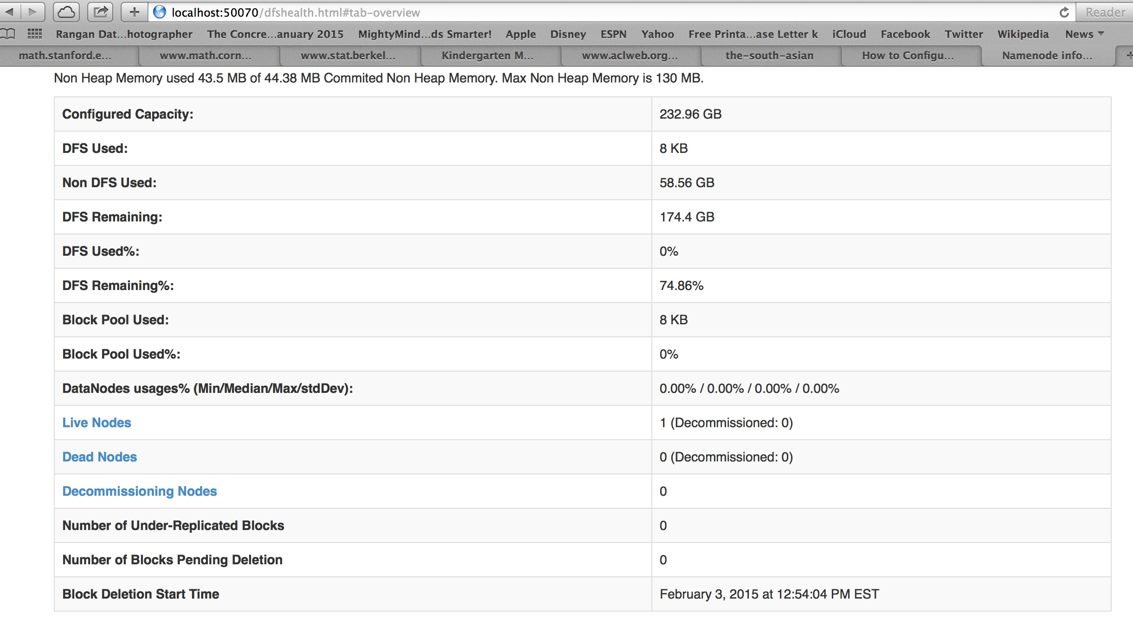
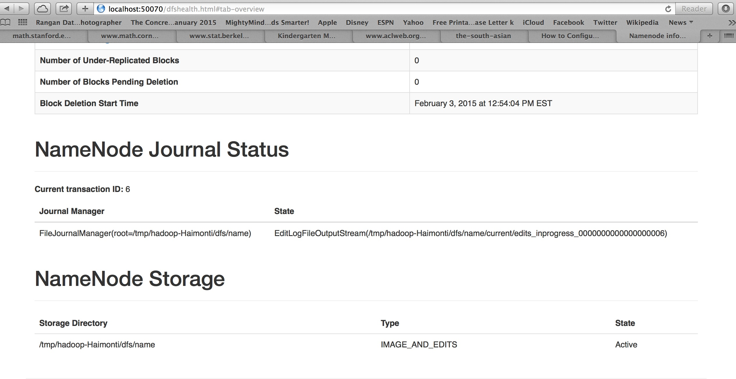
Checking the Hadoop installation
http://localhost:50070

Slide 18
Setting up the DFS continued
Make the HDFS directories required to execute MapReduce jobs
$bin/hdfs dfs –mkdir /user
$bin/hdfs dfs –mkdir /user/<username>
Can you find out where these
directories are using
the web interface?

Slide 19
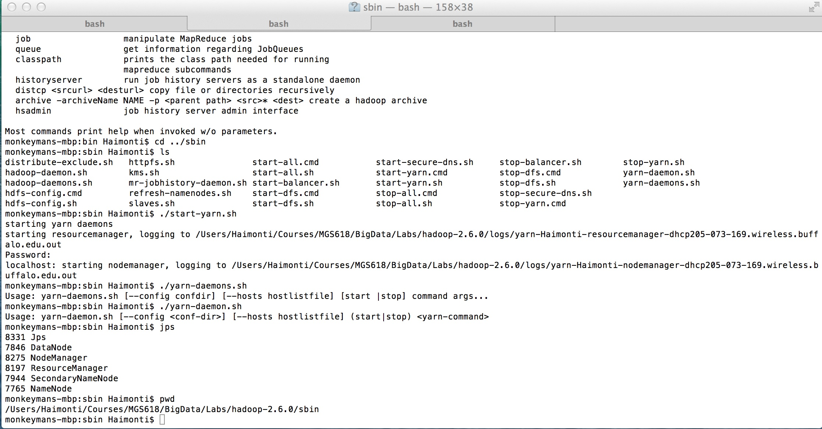
Starting YARN

Slide 20
Starting YARN
Browse the web interface for the resource manager
By default, it is available at
http://localhost:8088
Congratulations!
You can now run MapReduce jobs

Slide 21
Stopping the DFS and YARN
Go to <hadoop-install-dir>/bin from the command line and type
./stop-dfs.sh and
./stop-yarn.sh

